Slide 1




The Problem
Hidden Workflows
Manual Mapping
Buried in unstructured SOPs & manuals.
Slow, costly, error-prone processes.
Increased Risks
Compliance gaps & operational failures.

Slide 2


Our Insight
Process maps: Essential for compliance & efficiency.
Manual extraction: Wastes time, resources, capital.
Automation: Unlocks massive savings, mitigates risk.

Slide 3
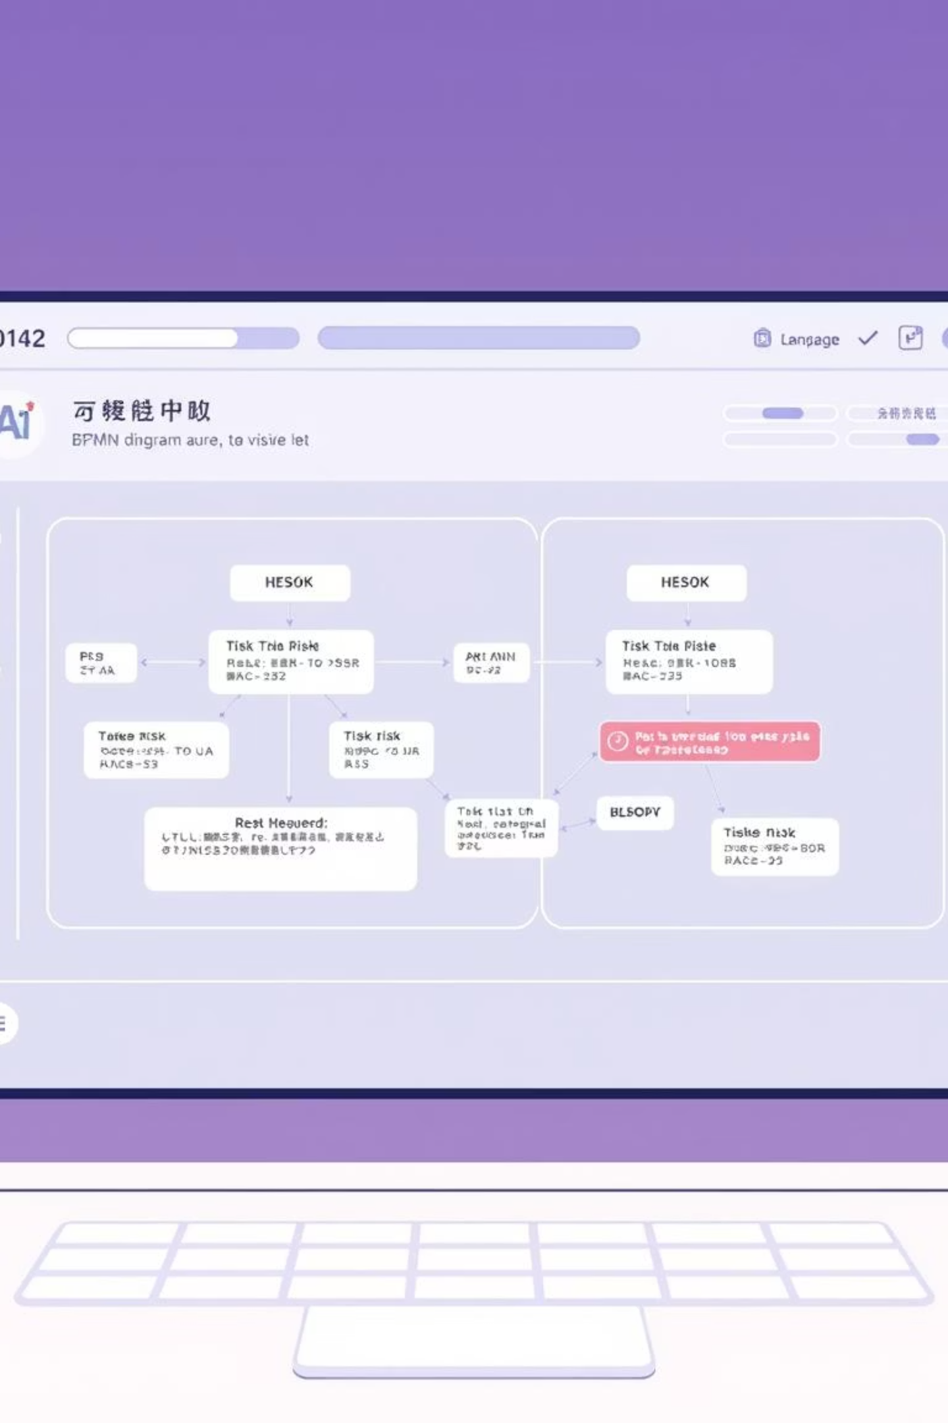




Our Solution
AI-powered Document Analysis
Automated Process Mapping (BPMN)
Intelligent Risk & Control Identification
Seamless Data Export (JSON & BPMN XML)

Slide 4
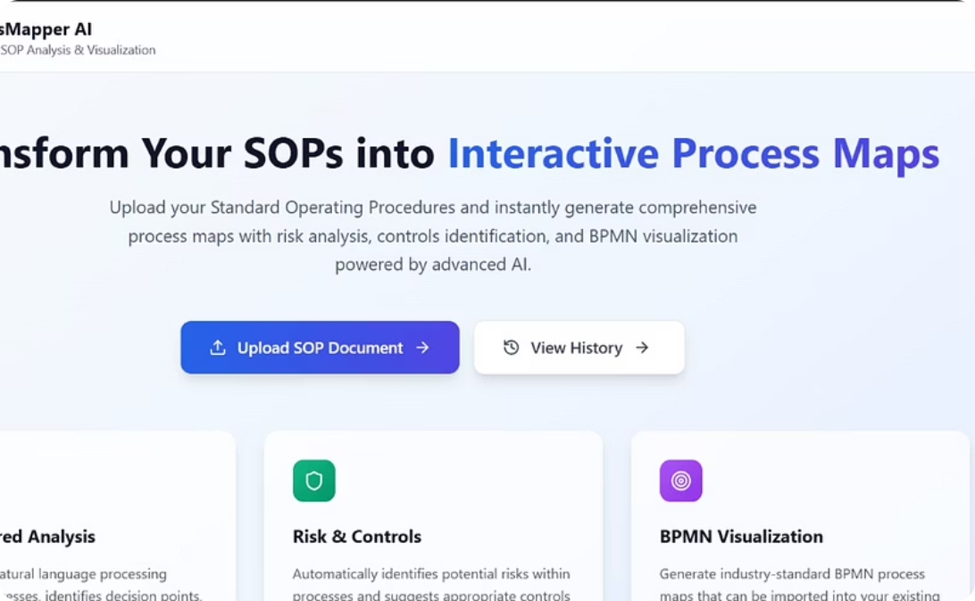
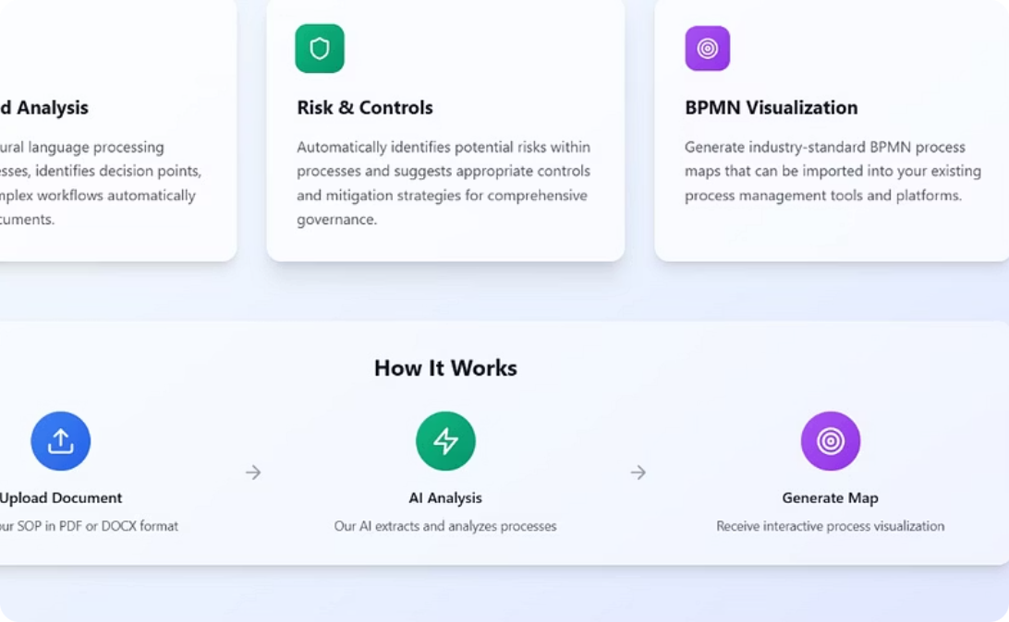
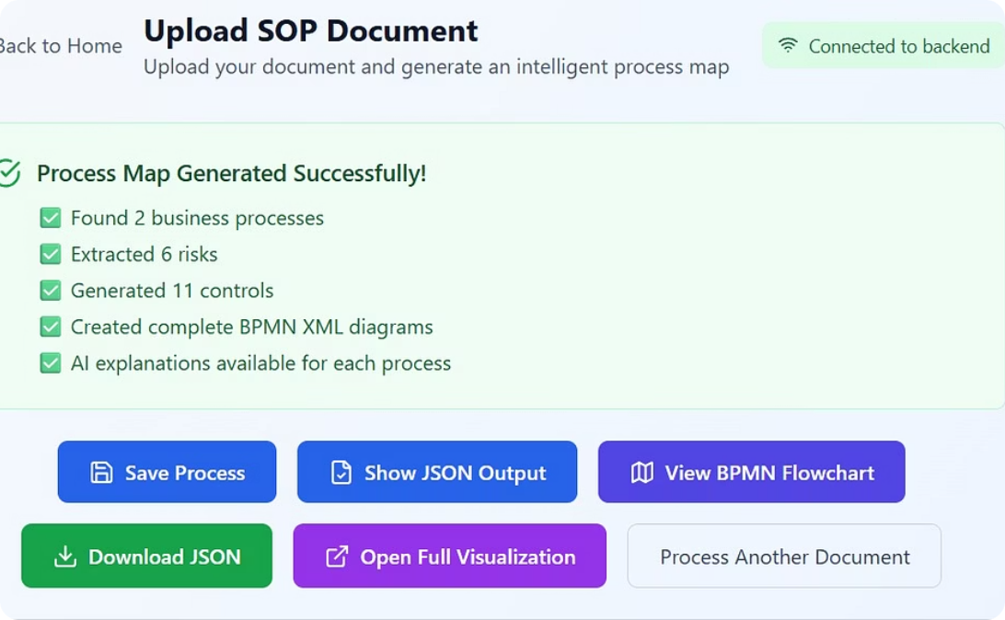
Demo
Upload documents, extract steps.
Visualize processes with BPMN; automatically highlight risks & controls.
Export structured output.

Slide 5

Resources & Links
GitHub Repository
Access our code and contribute

Slide 6





Next Steps
Domain Expansion
Banking, Insurance, Healthcare
Enhanced Accuracy
Hybrid AI + Knowledge Graph
SaaS Deployment
Enterprise Platform
Scalability
Handle Large Repositories

Slide 7
Thank You
deepdreamers
We appreciate your time and consideration.

